Slide 1
Project Report
On
“Smart City Traveler”
Submitted By
Miss. Demo1
Miss. Demo2
Under the guidance of
Prof. A. P. Date

Slide 2
Contents
Introduction
Aim
Objective
Scope
Processed Flow of System
Proposed Concept
Advantages & Disadvantages
Implication
Reference

Slide 3
Introduction
In day-to-day life, people are interested in traveling and searching for the different tourist location for travel planning in which they are interested. Social media has come out continuous needs for automatic travel recommendation. This becomes an important problem in research and industry. Social media offers great opportunities to address many challenging problems, like GPS estimation and travel recommendation. Travelogue websites offer rich descriptions about landmarks and traveling experience written by users. Among all the applications, travel recommendation is especially attractive to many researchers because of the importance and the intrinsic relationship with people’s everyday lives. In general, a typical travel recommendation system consists of two aspects: generic recommendation and personalized recommendation ..

Slide 4
Aim
“To analyze & developing a tourism project requires careful planning and consideration of a variety of factors..”

Slide 5
Objectives
Increase tourism revenue: One of the primary objectives of a tourism project is to generate revenue by attracting more visitors to a particular destination.
.Enhance the visitor experience: Another objective of a tourism project is to provide visitors with an exceptional experience that meets or exceeds their expectations.
Promote sustainable tourism practices: Tourism projects can have a significant impact on the environment and local communities..
Increase awareness and visibility of the destination: Another objective of a tourism project may be to increase the visibility and awareness of the destination among potential visitors..
Develop new tourism products: A tourism project may also aim to develop new tourism products or experiences that cater to the needs and preferences of different types of visitors.
.Foster economic development: Finally, a tourism project may aim to foster economic development in the destination by creating jobs, promoting entrepreneurship, and supporting local businesses.

Slide 6
Scope
The scope of a tourism project depends on the specific goals and objectives of the project. However, here are some common areas that a tourism project may focus on:
Destination development: This involves developing and enhancing the physical infrastructure and tourism products of a destination to make it more attractive to visitors. This may include building new accommodations, attractions, and recreational facilities, as well as improving transportation and other infrastructure.
Marketing and promotion: A tourism project may focus on developing marketing and promotion strategies to increase awareness of a destination and attract more visitors. This may include advertising campaigns, social media promotions, and other marketing initiatives.
Sustainable tourism development: A tourism project may focus on promoting sustainable tourism practices that minimize negative impacts on the environment and local communities while maximizing the benefits of tourism for the destination.
Community involvement: A tourism project may involve engaging local communities in the development and promotion of tourism in the area. This can help to build community support and ensure that the project benefits local residents.
Cultural and heritage tourism: A tourism project may focus on promoting the cultural and heritage assets of a destination to attract visitors who are interested in learning about the local culture and history
.Adventure tourism: A tourism project may focus on developing adventure tourism products and experiences, such as hiking, kayaking, or zip-lining, to attract visitors who are seeking more active and adventurous vacations.
Tourism education and training: A tourism project may involve providing education and training to local residents and tourism operators to improve the quality of tourism products and services and ensure a high level of customer satisfaction.

Slide 7
Processed Flow Of System

Slide 8
Proposed Concept
Add Package
Update Package
Delete Package
View Customer Information
Company Registration
DSS Reporting

Slide 9
User Module
View Package
Registration For Package
Login

Slide 10
Proposed Algorithm Approach
Tourist Area Collaborative Relation Topic(TACRT).
The step of algorithm of collaborative approach is described as followers:
Step 1: The user must registered into the system User set {u1, u2……….un}.
Step 2: Each user record saves into the system with security.
Step 3: The request comes from various nodes with their ip addresses. The server sends the notification to each user set {Um1…….Umn}.
Step 4: The system records interest of each user according to searching pattern. User set {u1……………... un}
U Interest Set {I1……… In}
Step 5: Package recommendation phase activated according to mutual user account Package Set { p1…………. Pn }
If( u1 = = I1)
Then u1= p1
Step 6: The step 5 repeat every time for each and every new and existing user.
Where,
u1……un indicates user list,
Um1…Umn indicates registration confirmation message
I1……In indicates user interested set
p1……pn indicates packages set

Slide 11
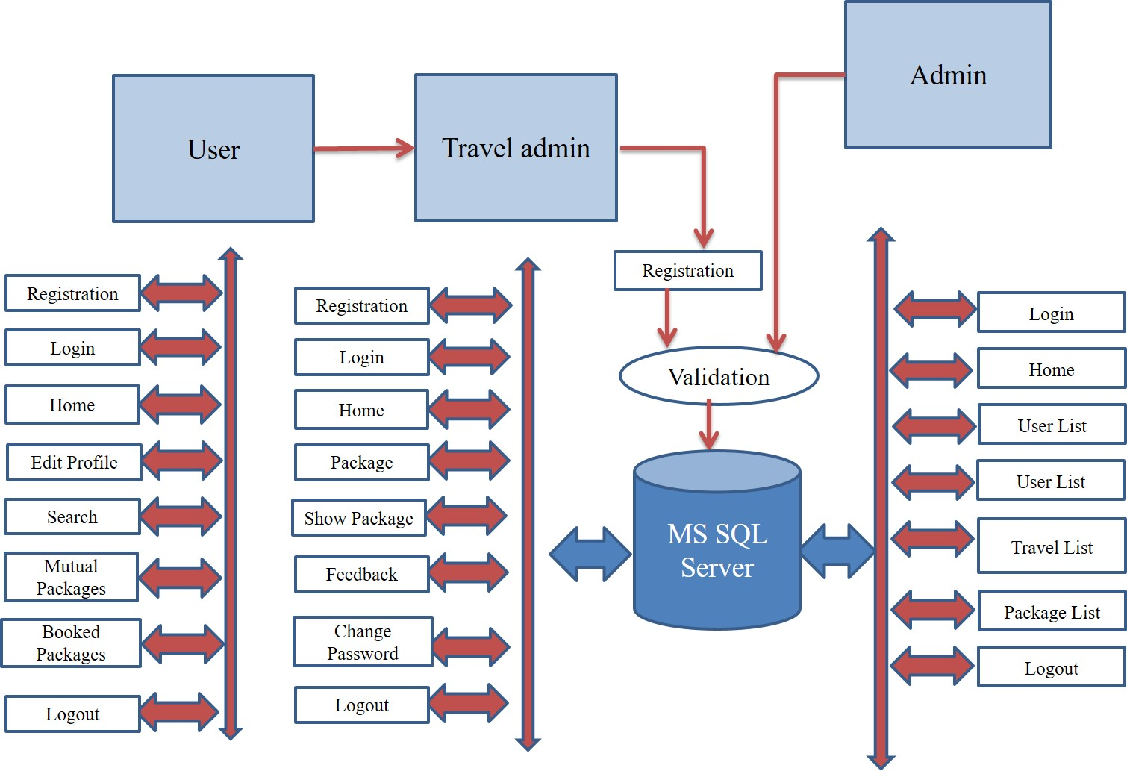
Action Plan

Slide 12
Advantages
Manual operator control: Manual operator control is use for accessing
complaints information.
User friendly
Placed Complaints Easily by user.

Slide 13
Disadvantages
Environmental impact.
Cultural impact.
Infrastructure strain.
Overcrowding.

Slide 14
Implication
This Project explains a recommendation system for personalized travel sequence. This recommendation system considers the user interest with another attribute of users like time, season, and value of travel. Using this social media knowledge not solely mining users purpose of interest however additionally the travel sequence of the purpose of interest with considering alternative attribute of user. There are many alternative forms of strategies, algorithms and technologies that are used for recommendation. However still there are some issues. The planned system provides a more robust resolution for travel package recommendation. In planned technique, a user is in a position to urge packages counseled by the system. This technique traces the profile info and user searches pattern found the interest of the user, and supply the suitable travel package to user. In result analysis shows details exhaustion about travel package recommendation model in graph shows the time required for Recommendation According to users.

Slide 15
Reference
[1] Yan-Ying Chen, An-Jung Cheng, and Winston H. Hsu,” Travel Recommendation by Mining People Attributes and Travel Group Types From Community-Contributed Photos”, IEEE TRANSACTIONS ON MULTIMEDIA, VOL. 15, NO. 6, OCTOBER 2013, paper 2,3.
[2] S. Lai et al., “Hybrid Recommendation Models for Binary User Preference Prediction Problem,” Proc. KDD- Cup 2011 Competition,2011.
[3] Yong Ge, Qi Liu1, Hui Xiong, Alexander Tuzhilin, Jian Chen,” Cost-aware Travel Tour Recommendation,” 17th ACM SIGKDD international conference on Knowledge discovery and data mining, August 21 - 24, 2011.
[4] Yu Zheng, Lizhu Zhang, Xing Xie, Wei-Ying Ma,” Mining Interesting Locations and Travel Sequences from GPS Trajectories”, International conference on World Wide Web 2009 April 2009.
[5] Shuhui Jiang, Xueming Qian, Tao Mei, Yun Fu, “Personalized Travel Sequence Recommendation on Multi-Source Big Social Media”, IEEE TRANSACTIONS ON BIG DATA, VOL. X, NO. X, SEPTEMBER 2016
[6] Logesh Ravi and Subramaniyaswamy Vairavasundaram,” A Collaborative Location Based Travel Recommendation System through Enhanced Rating Prediction for the Group of Users”, Hinda Wi Publishing Corporation Computational Intelligence and Neuroscience Volume 2016,
[7] Ling Xing, Qian Ma, Song Chen,” A Novel Personalized Recommendation Model based on Location Computing”, Chinese Automation Congress (CAC),20-22 Oct. 2017.
[8] Hassan Takagi, James B. D. Joshi, Hassan A. Karimi,” A Collaborative K -anonymity Approach for Location Privacy in Location-Based Services”, 5th International Conference on Collaborative Computing: Networking, Applications and Work sharing 11-14 Nov. 2009.

